Slide 1

Research Project Plan 2020-2021
Chanthan HEL
Lecturer
Department of Telecommunications and Networking Engineering,
Institute of Technology of Cambodia

Slide 2
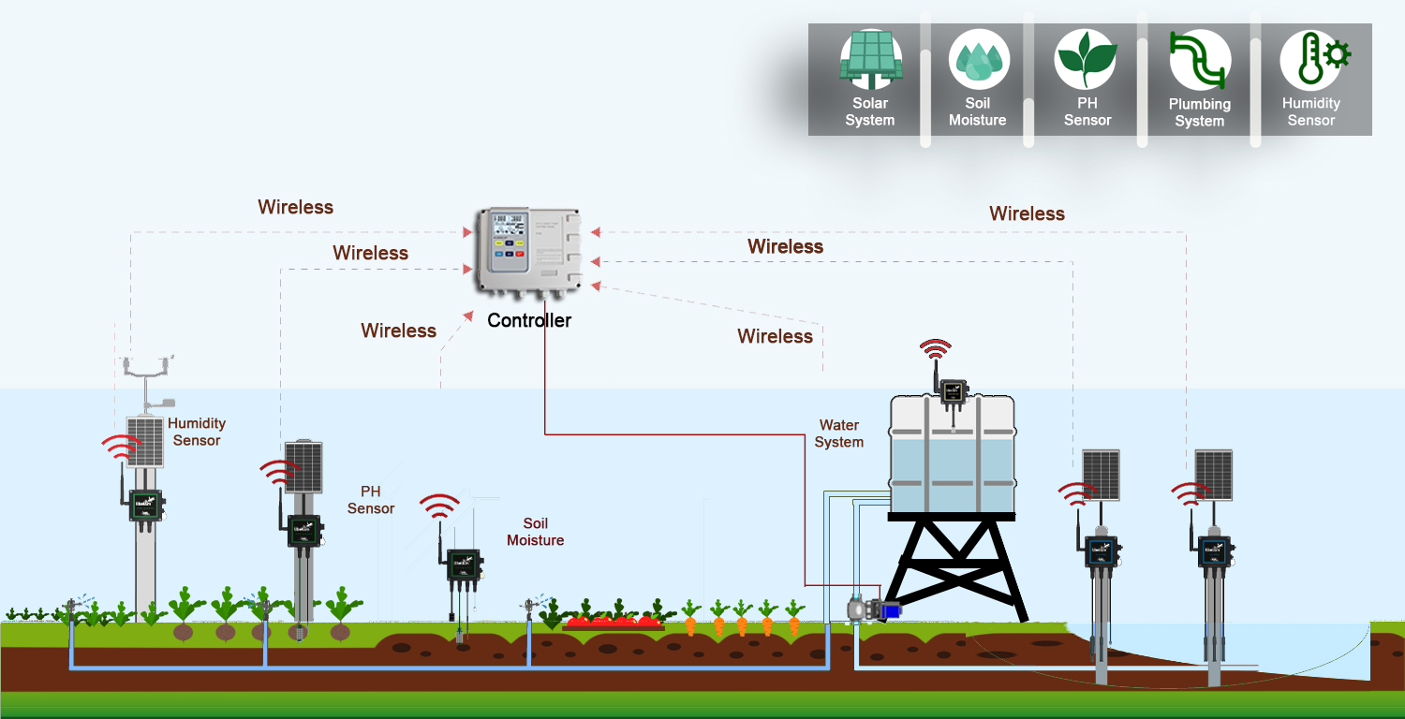
I. Focused Area
Offline-Automatic irrigation system/Module (RUA, ITC Greenhouse)
WSN/Module for open space/Large farm (Monitoring and control of environmental and soil data)

Slide 3
I. Focused Area
2. Online-Automatic irrigation system/Module (RUA, ITC Greenhouse)
WSN/Module for open space/Large farm (Monitoring and control of environmental and soil data)

Slide 4
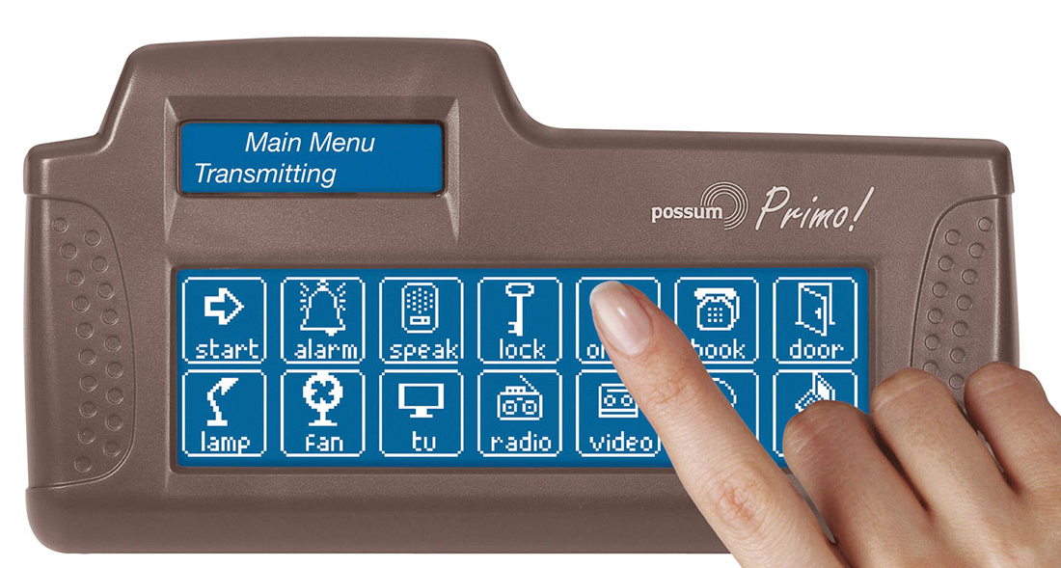
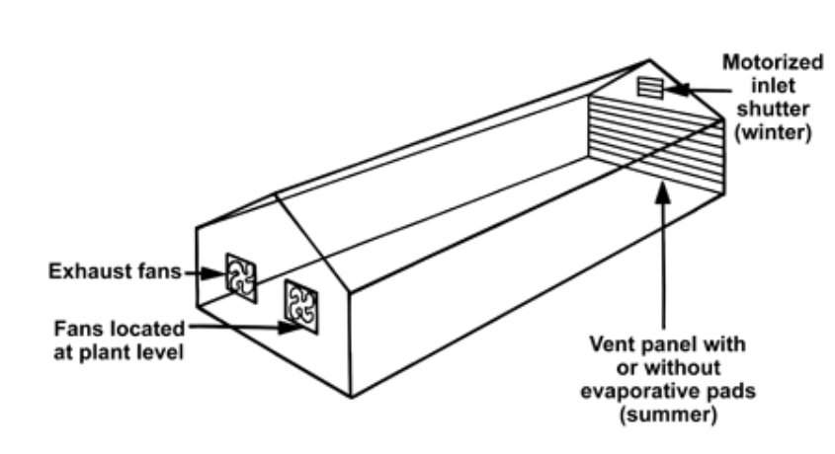
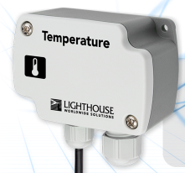
I. Focused Area
3. On/Offline-Greenhouse Environmental monitoring and control Module (LBE’s mushroom Project, ITC Greenhouse, FabLab)
Output
Input
Maxiaid.com

Slide 5
I. Focused Area
4. Multi purpose tester for agriculture: (Rengsey)
Soil moisture/Temperature
Soil/water pH
Ambient temperature/Humidity
Nutrient

Slide 6
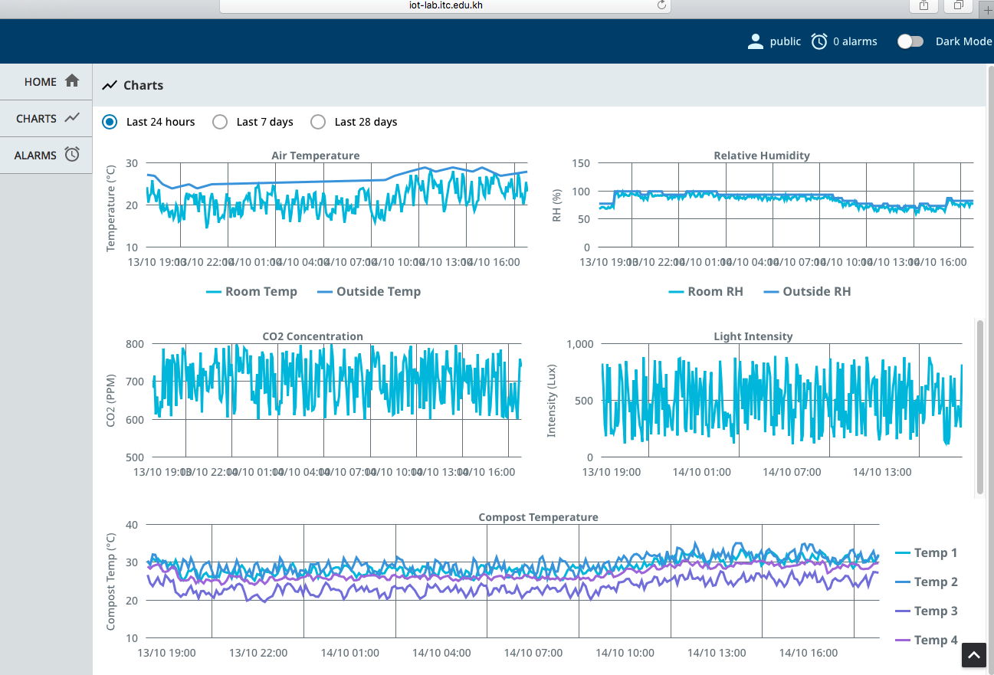
I. Focused Area
5. Farm’s data storage, monitoring and analytics: (FabLab, ITC Greenhouse)
Backend: Server, Database
Frontend development:
Web application and mobile application
Machine learning/AI for
smart farming

Slide 7
II. ITC Greenhouse

Slide 8
II. ITC Greenhouse (Bunrong and Thavath)
Monitoring and control system
2 sensor nodes:
Temp, humi, soil moisture, solar radiation
Connect controller via Zigbee
1 Controller/Coordinator
Control solenoid valve
Display on LCD
Send data to thinkspeak.com server via esp8266 connected to Wireless access point
1 Controller:
Read water flow rate via flow rate sensor
Read energy usage via smart meter rs485
Control water level in the tank
1 Controller to record the image using RPI and send to cloud

Slide 9
II. ITC Greenhouse (Student work)
Sovannroth
Build backend to store and manage farm data
Develop web and app front and for farm monitoring and control

Slide 10
II. ITC Greenhouse (Student work)
Nita
Apply machine learning and data analytic for agricultural application
Specific case study will be selected

Slide 11
III. Mushroom Project (Student work)
Rengsey: Assembly control and monitoring system for mushroom house
Nita: Mushroom data analytic
Sovannroth: Modify server for data storage and view

